Slide 1
Machine Learning DSECL ZG565
Dr. Monali Mavani
These slides are prepared by the instructor, with grateful acknowledgement of Tom Mitchell, Andrew Ng< Prof. Chetana, Prof. Vimal and many others who made their course materials freely available online.

Slide 2
Session Content
Perceptron (Chapter 4 Tom Mitchell)
Neural Network Architecture (Andrew Ng Notes and Chapter 4 Tom Mitchell)
Back propagation Algorithm (Andrew Ng Notes)

Slide 3
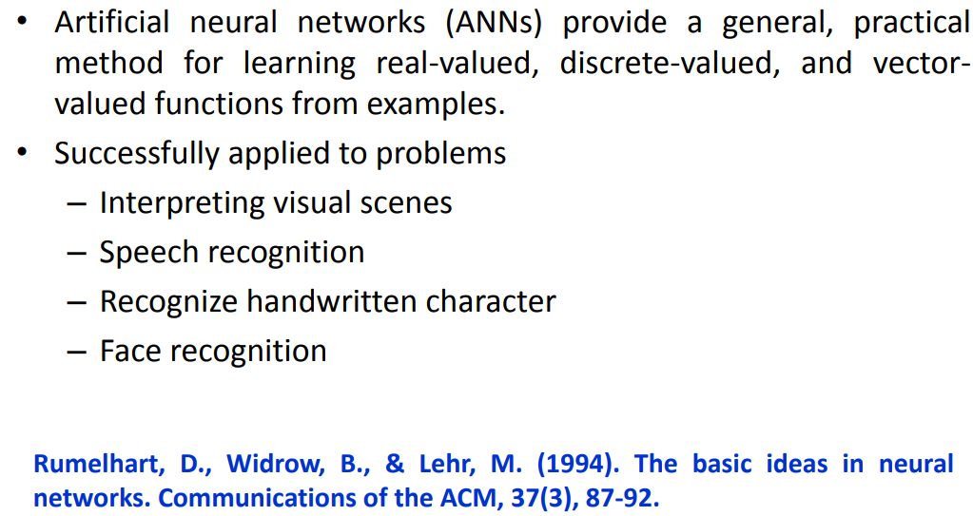
Artificial Neural Network

Slide 4
Neural Networks
Origins: Algorithms that try to mimic the brain.
Very widely used in 80s and early 90s; popularity diminished in late 90s.
Recent resurgence: State-of-the-art technique for many applications
Artificial neural networks are not nearly as complex or intricate as the actual brain structure
Based on slide by Andrew Ng
8

Slide 5
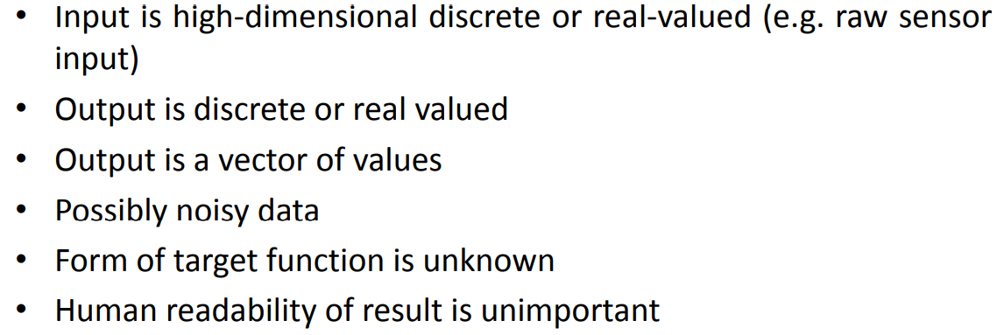
When to use Neural Network

Slide 6
Biological Neurons
dendrites
cell
axon
synapse
dendrites
Biological Neuron | Artificial Neuron
Cell Nucleus (Soma) | Node
Dendrites | Input
Synapse | Weights or interconnections
Axon | Output

Slide 7
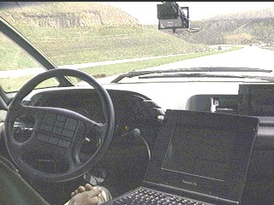

Slide 10
Perceptron
A perceptron is s unit that takes a vector of real-valued inputs, calculates a linear combination of these inputs, then outputs a 1 if the result is greater than some threshold and -1 otherwise

Slide 12
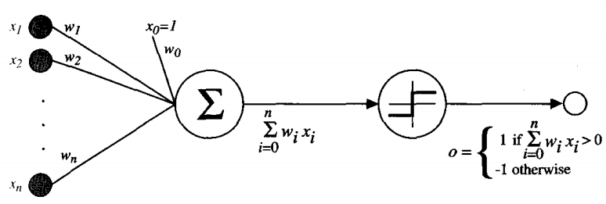
Perceptron
The quantity (-w_{O}) is a threshold that the weighted combination of inputs w₁x₁ + . . .+ w_{n}x_{n} must surpass in order for the perceptron to output a 1.
Space H of candidate hypotheses:

Slide 13
AND Network

Slide 14
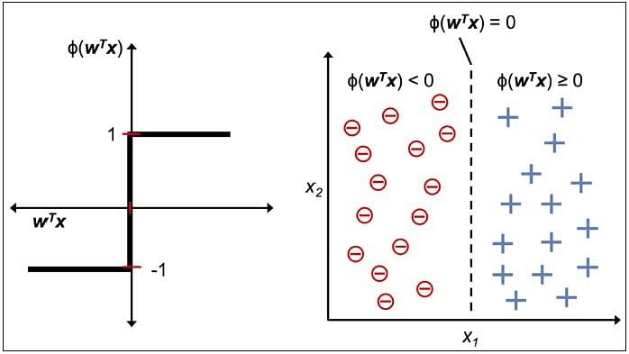
Perceptron Decision Surface

Slide 15
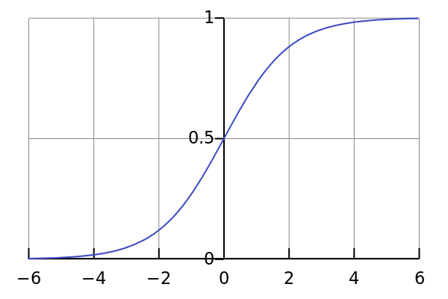
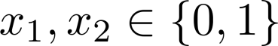
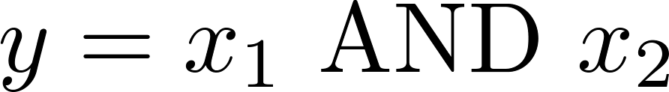
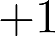
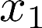
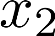
Representing Boolean Functions
Logistic / Sigmoid Function
Simple example: AND
g(z)
-30
+20
+20
h_{θ} (x)
x₁ | x₂
0 | 0
0 | 1
1 | 0
1 | 1
h_{Θ}(x)
x₁
x₂
h_{Θ}(x)
h_{Θ}(x) = g(-30 + 20x₁ + 20x₂)
0
0
g(-30) ≈ 0
g(-10) ≈ 0
g(-10) ≈ 0
g(10) ≈ 1
0
1
1
0
1
1
Based on slide and example by Andrew Ng
21

Slide 16
Representing Boolean Functions
OR
-10
+20
+20
h _{θ} (x)
22

Slide 17
Representing Boolean Functions
NOT
(NOT x₁) AND (NOT x₂)
+10
+10
h _{θ} (x)
-20
-20
-20
h _{θ} (x)

Slide 18
Combining Representations to Create Non-Linear Functions
AND
(NOT x₁) AND (NOT x₂)
OR
-10
+20
+20
-30
+20
+20
+10
-20
-20
h _{θ} (x)
h_{θ} (x)
h _{θ} (x)
23
Based on example by Andrew Ng

Slide 19
Training a Perceptron
. • Method 1: Perceptron training rule
• Method 2: Delta rule : LMS and gradient
descent.

Slide 20
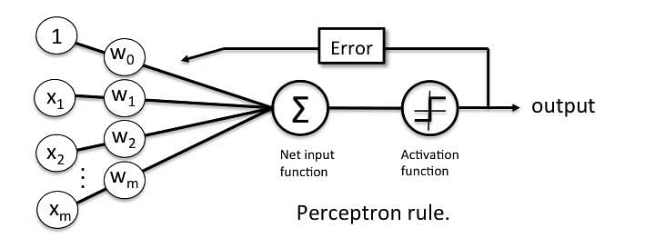
Method 1: perceptron training rule
weight update incrementally after each individual training sample
Figure Credit: https://sebastianraschka.com/Articles/2015_singlelayer_neurons.html#artificial-neurons-and-the-mcculloch-pitts-model

Slide 21
Method 1: perceptron training rule

Slide 23
Method 2: Delta rule : LMS and gradient descent.
Also known as Adaptive Linear Neuron (adaline), Widrow-Hoff rule
training an unthresholded perceptron; that is, a linear unit for which the output o is given by
We can define a cost function and use gradient descent optimization to update the weights.
Figure Credit: https://sebastianraschka.com/Articles/2015_singlelayer_neurons.html#artificial-neurons-and-the-mcculloch-pitts-model

Slide 24
Method 2: Delta rule : LMS and gradient descent.
Linear unit:
Define Error: ← Least squares method.
Gradient Decent:

Slide 25
Perceptron rule vs Delta rule
Gradient Descent and delta rule
For nonlinearly separable data
for a linear unit (or unthresholed
perceptron)
output “o” is a real number
Perceptron Training rule
for thresholded perceptron
output “o” is a class label
Will converge: If training data is linearly separable and n sufficiently small

Slide 26
Batch Vs Incremental
Batch Gradient Descent
Define the error for the whole training data, and consider it as a whole.
More stable. Easy to check convergence.
Large step size
Requires more computation in weight update stage
Stochastic Gradient Descent
Incremental (Online)Mode:
Define the error for each training instance, and consider it one by one.
can better avoid local minima, faster, deals with dynamic datasets

Slide 27
MULTILAYER NETWORKS AND THE BACKPROPAGATION ALGORITHM

Slide 29
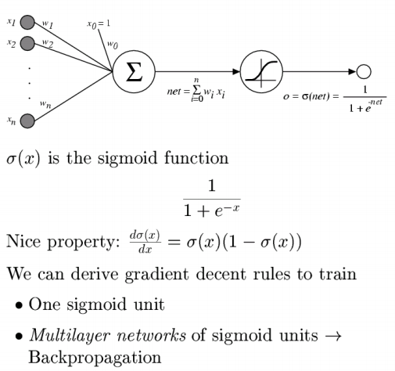
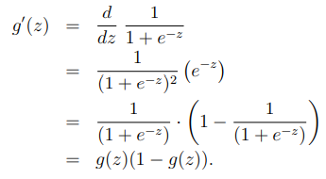
Perceptron: Sigmoid Function

Slide 30
Multilayer network
Single perceptrons can only express linear decision surfaces.
In contrast, the kind of multilayer networks learned by the FORWARD and BACKPROPAGATION algorithm are capable of expressing a rich variety of nonlinear decision surfaces

Slide 31
Neural networks
Output units
Hidden units Input units
Layered feed-forward network
Neural networks are made up of nodes or units, connected by links
Each link has an associated weight and activation level
Each node has an input function (typically summing over weighted inputs), an activation function, and an output
Based on slide by T. Finin, M. desJardins, L Getoor, R. Par
9

Slide 32
Feed-Forward Process
Input layer units are set by some exterior function (think of these as sensors), which causes their output links to be activated at the specified level
Working forward through the network, the input function of each unit is applied to compute the output value
Usually this is just the weighted sum of the activation on the links feeding into this node
The activation function transforms this input function into a final value
Typically this is a nonlinear function, often a sigmoid
function corresponding to the “threshold” of that node
Based on slide by T. Finin, M. desJardins, L Getoor, R. Par
13

Slide 33
Hidden Units
Hidden units are nodes that are situated between the input nodes and the output nodes.
Given too many hidden units, a neural net will simply memorize the input patterns.
Given too few hidden units, the network may not be able to represent all the necessary representations.

Slide 34
Example forward pass – simple NN

Slide 38
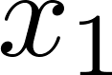
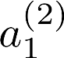
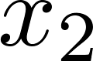
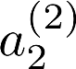
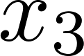
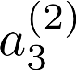
Neural Network
bias units
x₀
_{a}(2)
0
h_{θ} (x)
Layer 1
(Input Layer)
Layer 2
(Hidden Layer)
Layer 3
(Output Layer)
Slide by Andrew Ng
12

Slide 39
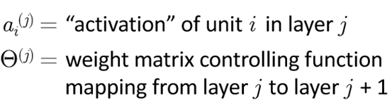
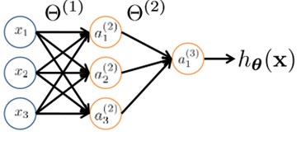
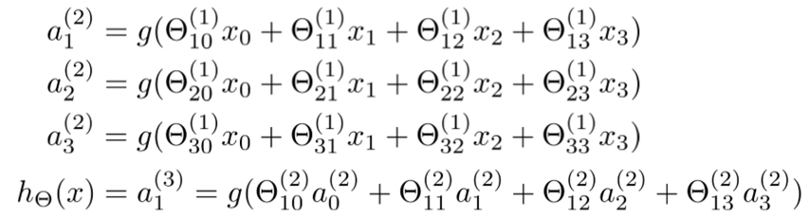
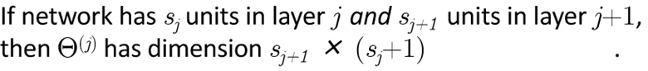
Neural Network
^{x}₀

Slide 40
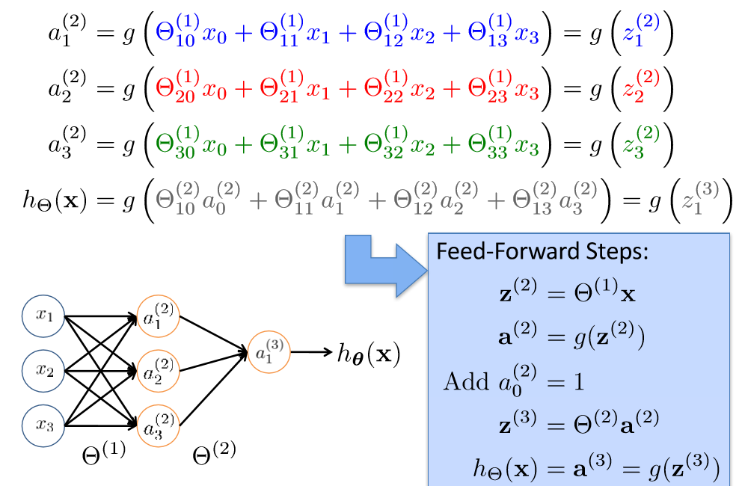
Vectorization

Slide 41
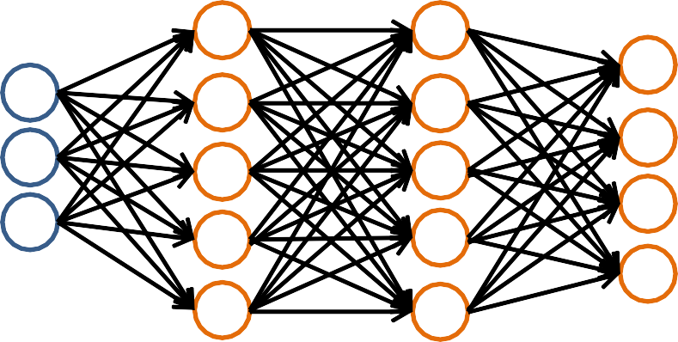
Forward Propagation
Given one labeled training instance (x, y):
Forward Propagation
a⁽¹⁾ = x
_{z}(2) _{= Θ}(1)_{a}(1)
_{a}(1)
_{a}(4)
a⁽²⁾ = g(z⁽²⁾)
_{z}(3) _{= Θ}(2)_{a}(2)
a⁽³⁾ = g(z⁽³⁾)
_{z}(4) _{= Θ}(3)_{a}(3)
[add a ⁽²⁾]
_{a}(2)
_{a}(3)
0
[add a₀⁽³⁾]
a⁽⁴⁾ = h_{Θ}(x) = g(z⁽⁴⁾)
Based on slide by Andrew Ng

Slide 42
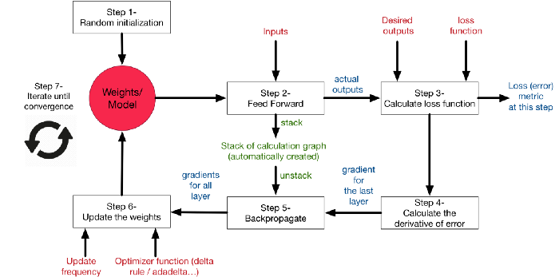
learning process on neural networks
Diagram Credit: Medium.com

Slide 43
Therefore ANN is specified by
an architecture: a set of neurons and links connecting neurons. Each link has a weight,
a neuron model: the information processing unit of the NN,
a learning algorithm: used for training the NN by modifying the weights in order to solve the particular learning task correctly on the set of training examples.

Slide 44
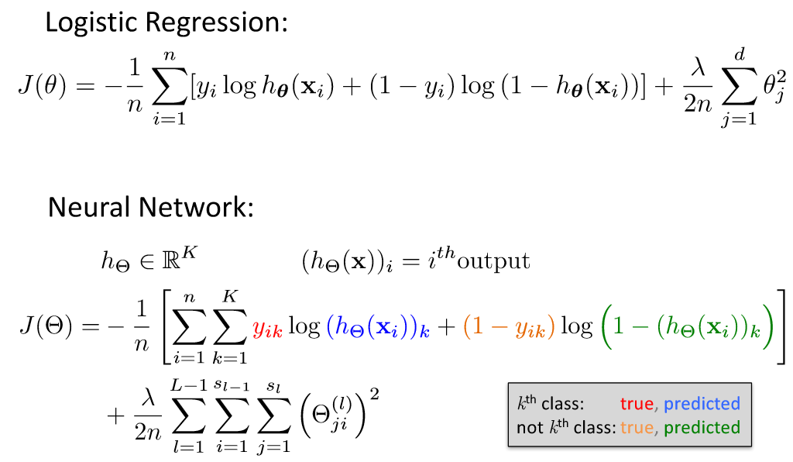
Cost Function (9.1 NN video of Andrew Ng)

Slide 45
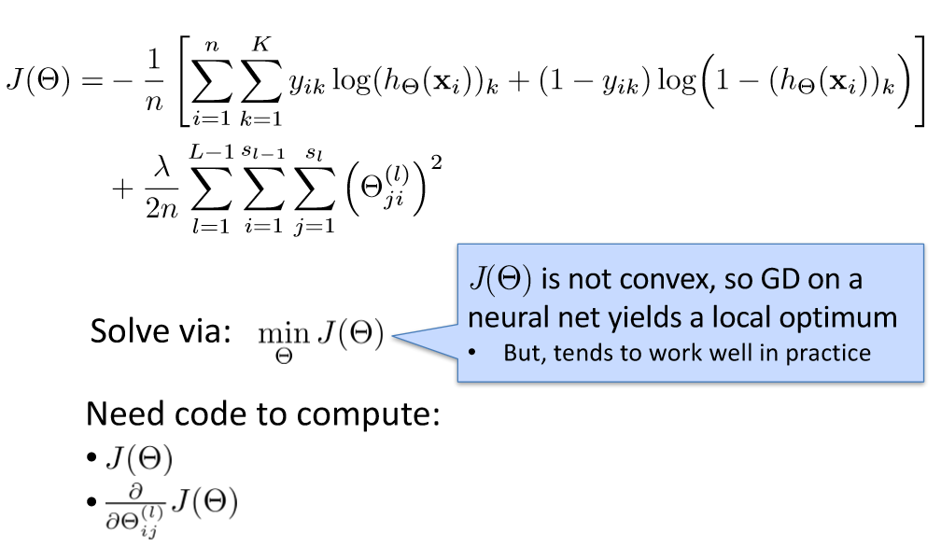
Optimizing the Neural Network

Slide 46
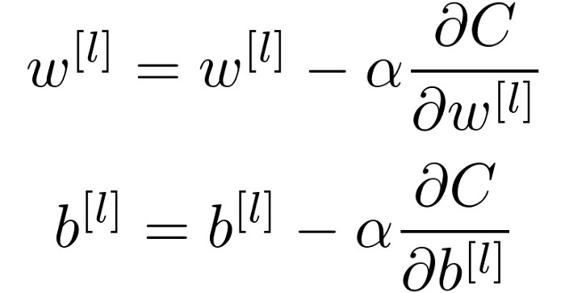
Gradient Descent

Slide 47
Learning in NN: Backpropagation
Similar to the perceptron learning algorithm, we cycle through our examples
If the output of the network is correct, no changes are made
If there is an error, weights are adjusted to reduce the error
The trick is to assess the blame for the error and divide it among the contributing weights
Based on slide by T. Finin, M. desJardins, L Getoor, R. Par
31

Slide 48
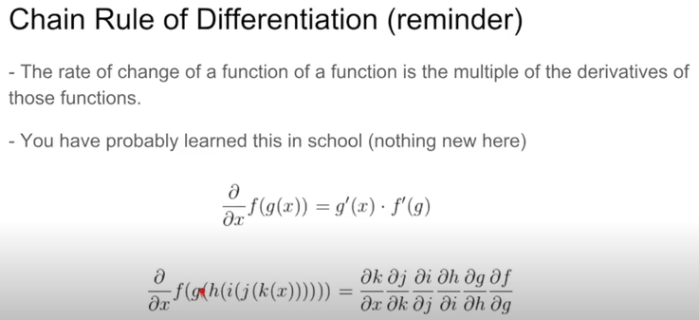
Chain rule

Slide 49
Backprop equation simple layer

Slide 50
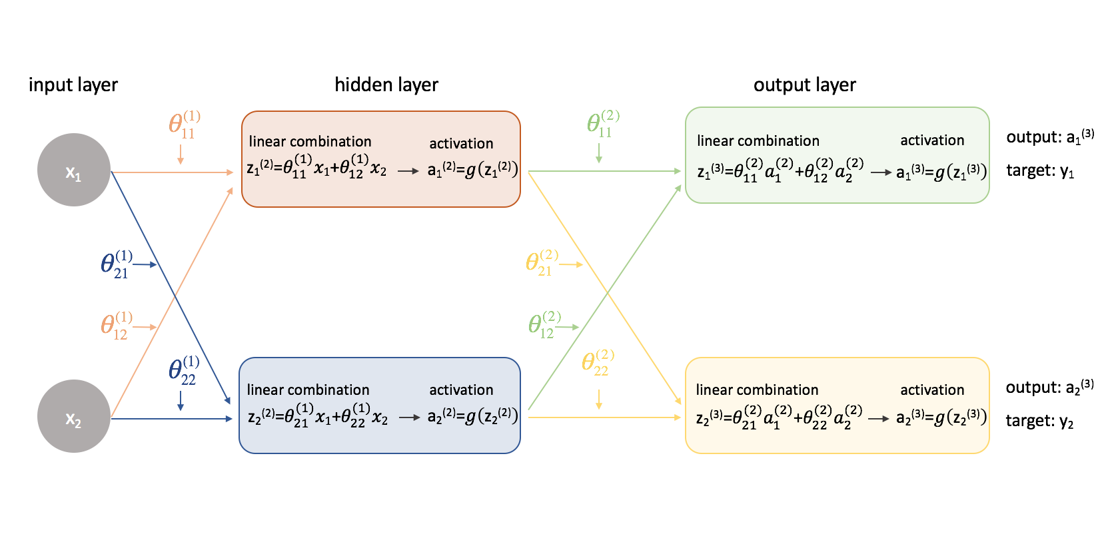
Example – back prop equations for 3 layer NN

Slide 52
Theta (1) parameters

Slide 53
Theta (2) parameters

Slide 54
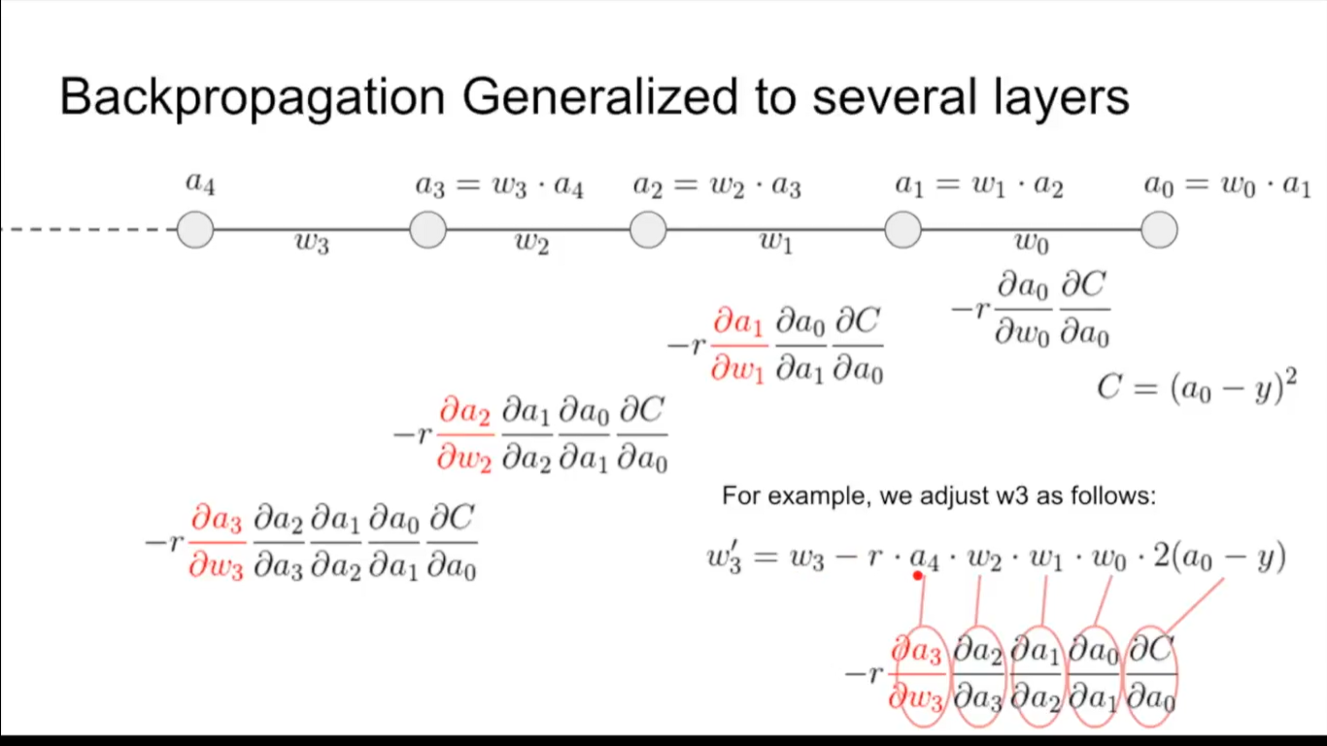
Backpropogation

Slide 55
Backpropagation Intuition
Each hidden node j is “responsible” for some fraction of the error δ_{j}^{(l)} in each of the output nodes to which it connects
δ_{j}^{(l)} is divided according to the strength of the connection between hidden node and the output node
Then, the “blame” is propagated back to provide the error values for the hidden layer
Based on slide by T. Finin, M. desJardins, L Getoor, R. Par
35

Slide 56
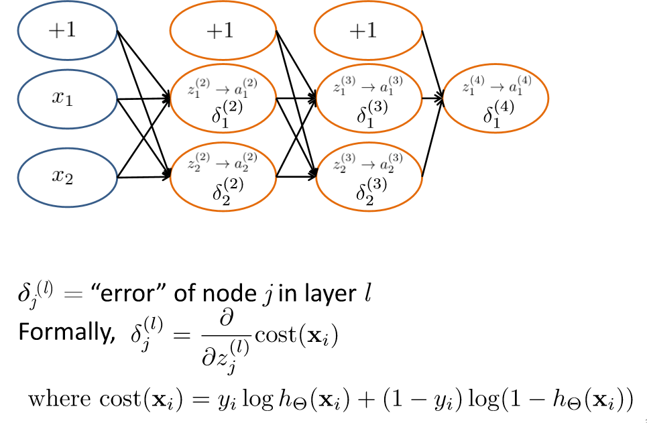
Backpropagation Intuition

Slide 57
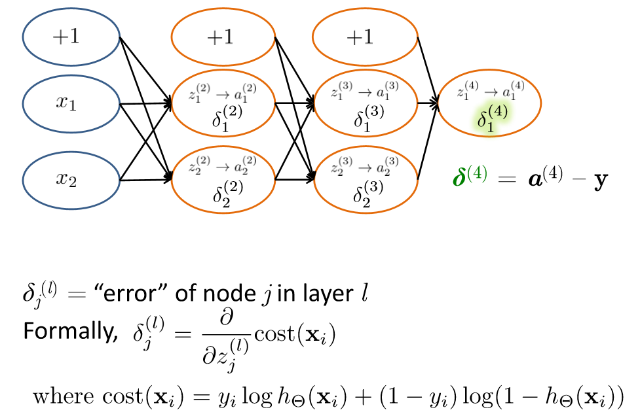
Backpropagation Intuition

Slide 58
Derivation last layer error

Slide 59
Other than last layer error derivation

Slide 60
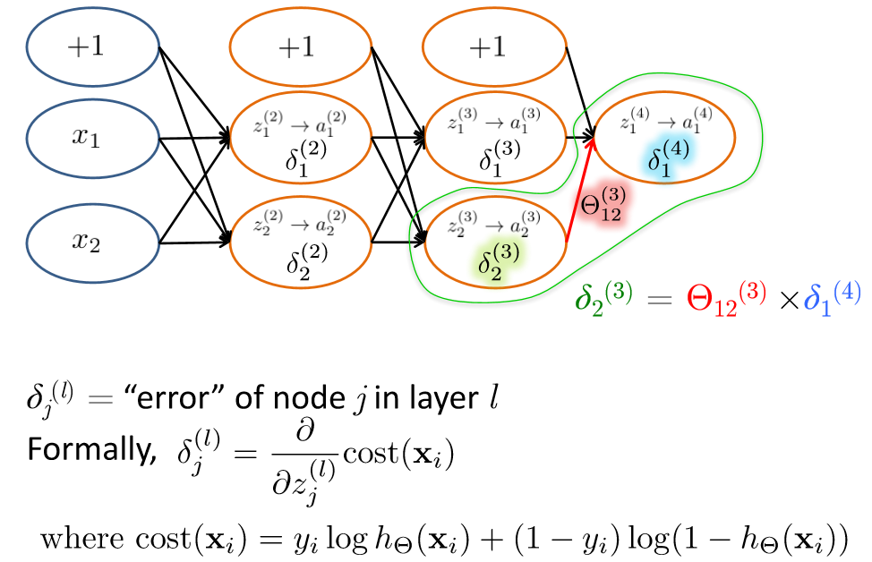
Backpropagation Intuition

Slide 61
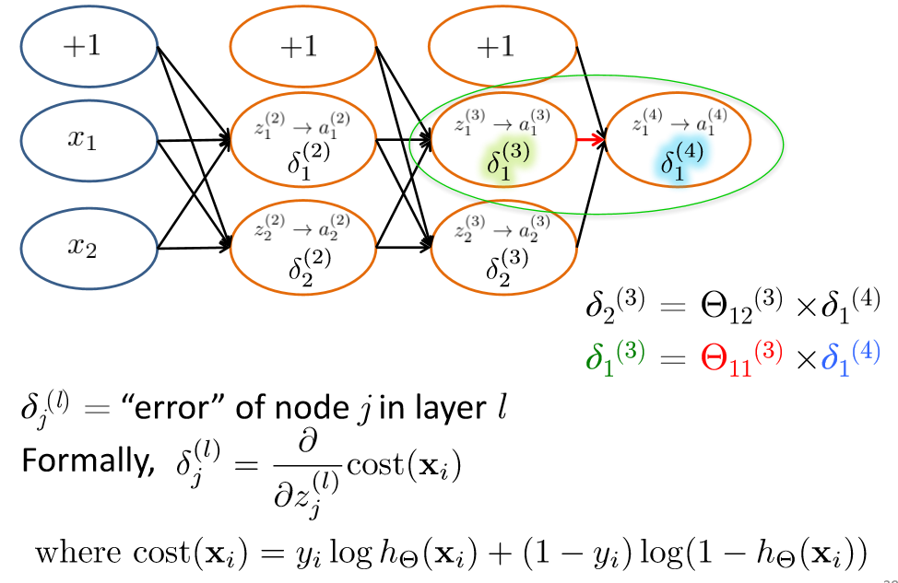
Backpropagation Intuition

Slide 62
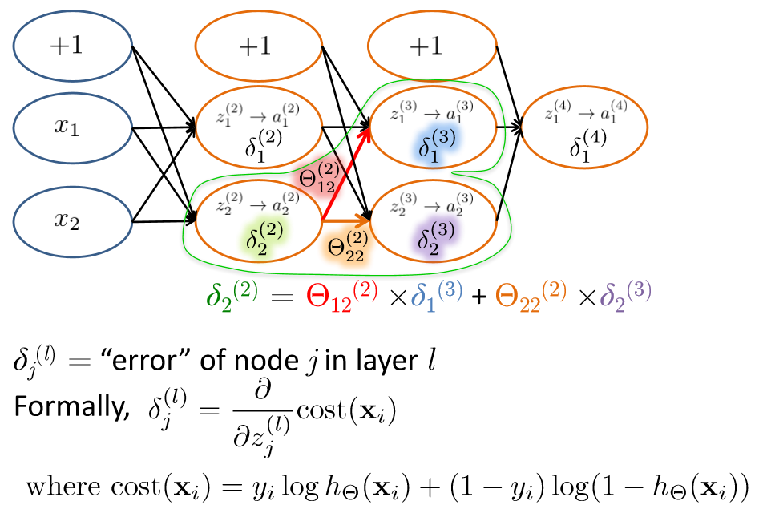
Backpropagation Intuition

Slide 63
Cost function using error term

Slide 64
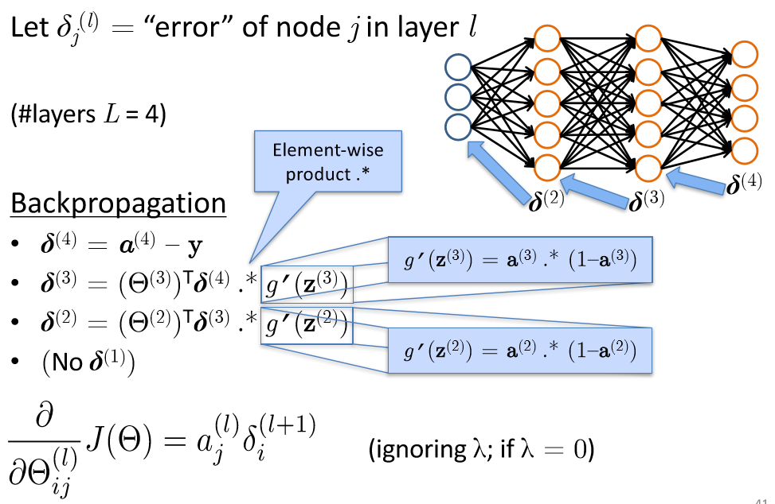
Backpropagation: Gradient Computation

Slide 66
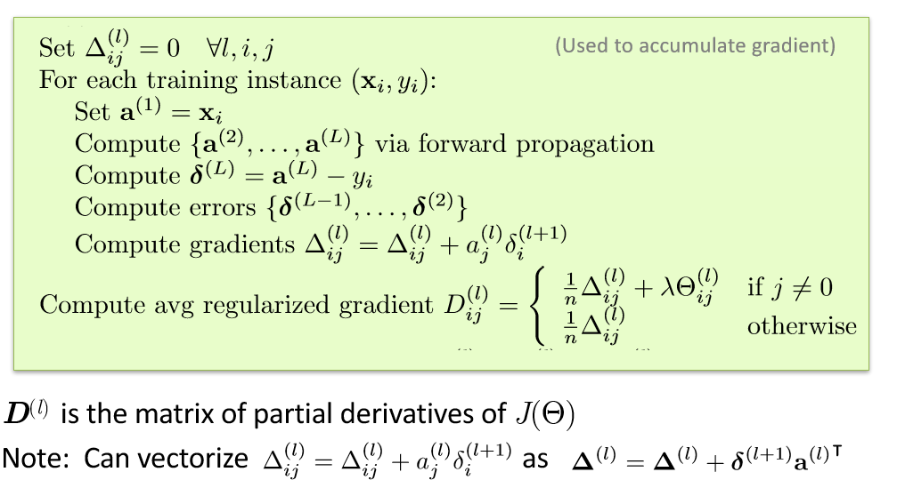
Backpropagation

Slide 67
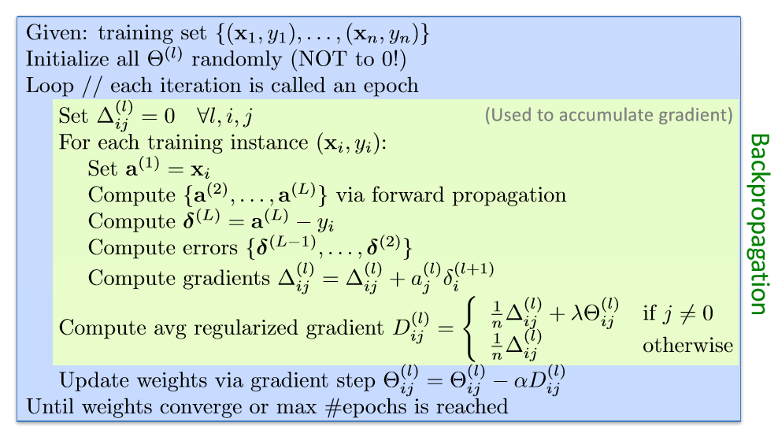
Backpropagation

Slide 68
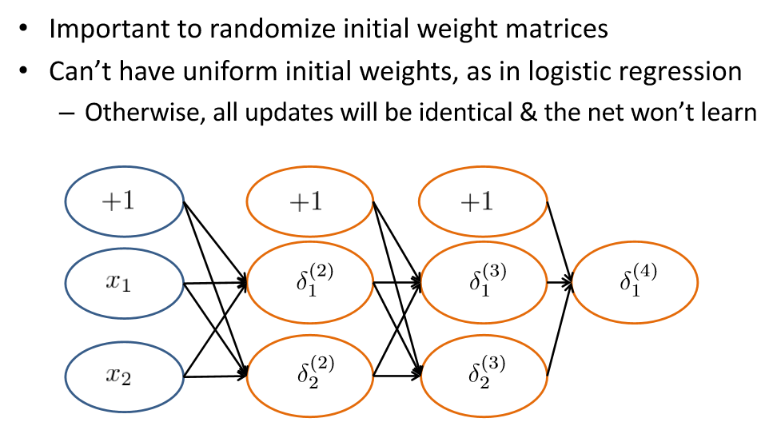
Random Initialization

Slide 69
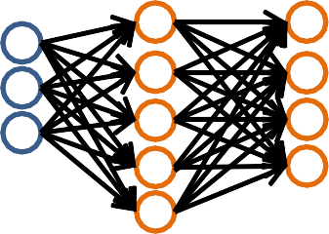
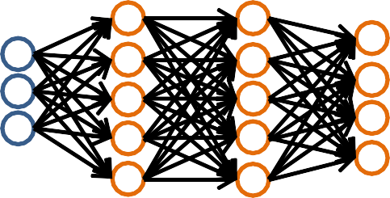
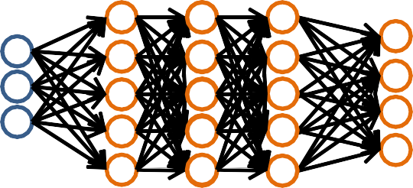
Training a Neural Network
Pick a network architecture (connectivity pattern between nodes)
# input units = # of features in dataset
# output units = # classes
Reasonable default: 1 hidden layer
or if >1 hidden layer, have same # hidden units in every layer (usually the more the better)
Based on slide by Andrew Ng

Slide 70
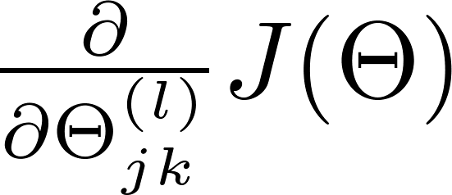
Training a Neural Network
Randomly initialize weights
Implement forward propagation to get h_{Θ}(x_{i})
for any instance x_{i}
Implement code to compute cost function J(Θ)
Implement backprop to compute partial derivatives
Use gradient checking to compare
computed using backpropagation vs. the numerical gradient estimate.
– Then, disable gradient checking code
Use gradient descent with backprop to fit the network
Based on slide by Andrew Ng

Slide 71
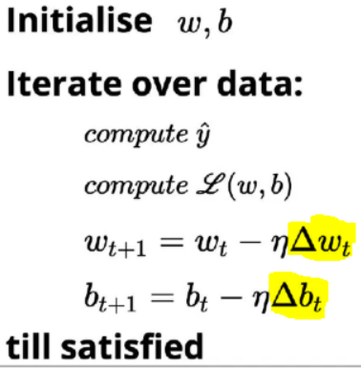
Gradient Descent
Please note that w and θ are the two notations used to represent weights of the model. Some books refer as w and some books refer as θ .

Slide 72
Other Network Architectures
s = [3, 3, 2, 1]
h_{θ} (x)
Layer 1 Layer 2 Layer 3
L denotes the number of layers
Layer 4
ϵN^{+L} contains the numbers of nodes at each layer
Not counting bias units
Typically, s₀ = d (# input features) and s_{L-1}=K (# classes)
s
16

Slide 73
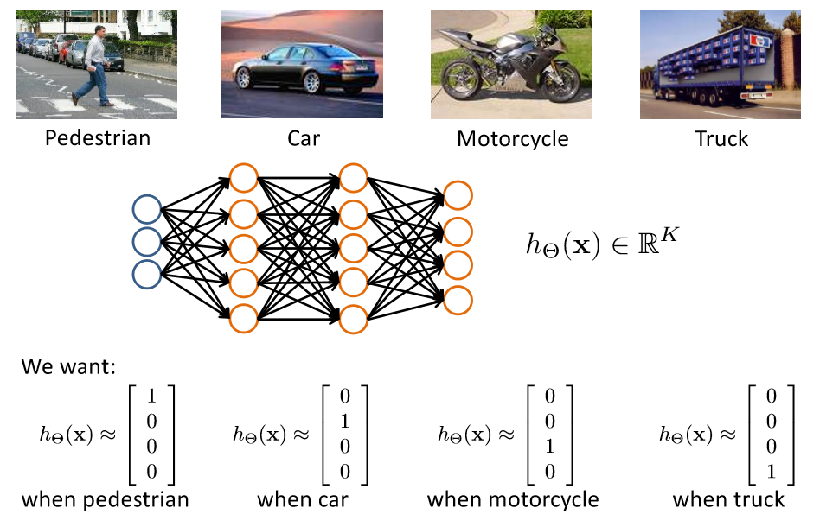
Multiple Output Units: One-vs-Rest

Slide 74
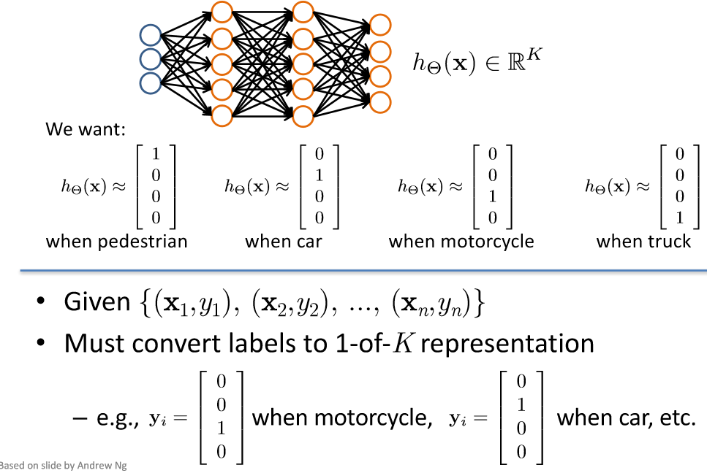
Multiple Output Units: One-vs-Rest

Slide 75

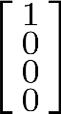



Neural Network Classification
Given:
{(x₁,y₁), (x₂,y₂), ..., (x_{n},y_{n})}
S ϵ N^{+L} contains # nodes at each layer
– s₀ = d (# features)
Binary classification
y = 0 or 1
1 output unit (s_{L-1}= 1)
Multi-class classification (K classes)
y ϵ R^{K}
e.g. , , ,
pedestrian car motorcycle truck
K output units (s_{L-1}= K)
Slide by Andrew Ng
19

Slide 76


Layering Representations
x₁ ... x₂₀
x₂₁ ... x₄₀
x₄₁ ... x₆₀
...
^{x}381 ^{... x}400
20 × 20 pixel images
d = 400 10 classes
Each image is “unrolled” into a vector x of pixel intensities

Slide 77


Layering Representations
x₁ x₂
x₃
x₄ x₅
Output Layer
“0”
“1”
“9”
x_{d}
Hidden Layer
Input Layer
Visualization of Hidden Layer

Slide 78
Andrew Ng videos on neural network
https://www.youtube.com/watch?v=EVeqrPGfuCY&list=PLLssT5z_DsK-h9vYZkQkYNWcItqhlRJLN&index=45
Autonomous driving using neural network
https://www.youtube.com/watch?v=ppFyPUx9RIU&list=PLLssT5z_DsK-h9vYZkQkYNWcItqhlRJLN&index=57
https://medium.com/binaryandmore/beginners-guide-to-deriving-and-implementing-backpropagation-e3c1a5a1e536

Slide 79
Handwriting Recognition
LeNet 5 Demonstration:
http://yann.lecun.com/exdb/lenet/
http://yann.lecun.com/exdb/lenet/weirdos.html

Slide 80

Derivative of sigmoid activation function

